Slide 1
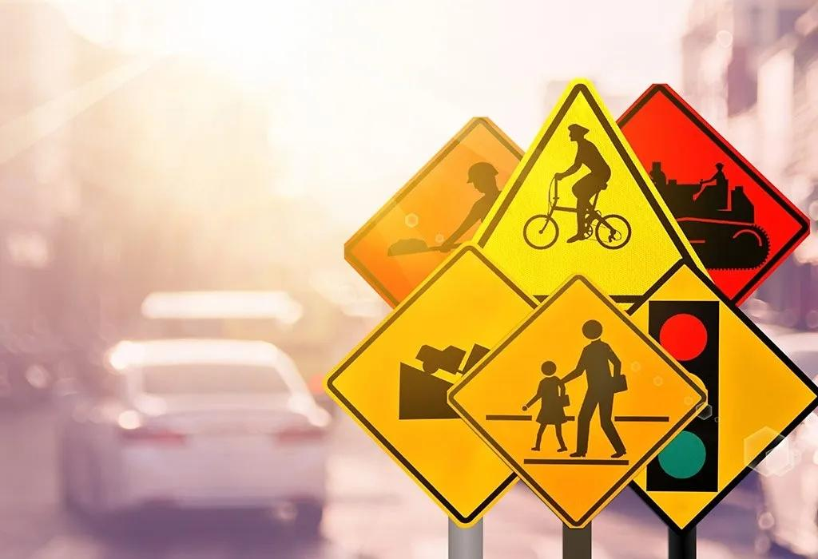
TRAFFIC MANAGEMENT
TRAFFIC MANAGEMENT
Shibina.SS
Phase 2 Submission Document
Project: Traffic Management
Introduction
Traffic management is the organisation, arrangement, guidance and control of both stationary and moving traffic, including pedestrians, bicyclists and all types of vehicles. Its aim is to provide for the safe, orderly and efficient movement of persons and goods, and to protect and, where possible, enhance the quality of the local environment on and adjacent to traffic facilities. This book is an introduction to traffic management, written in laypersons' language, and assuming no background knowledge of the subject.

Slide 2
Various basic traffic characteristics relating to road users, vehicles and roads, and traffic regulation and control, are discussed, including some traffic volume and traffic flow considerations relevant to traffic management. For effective traffic management, it is essential that the practitioner works from factual information. Road inventory and statistical methods, and the more common types of traffic studies, including traffic volume and composition, origin and destination, speed, travel time and delay, accidents and parking are described. "Before and after" studies, and estimation of future traffic are also covered. As a basis for logically applying traffic management techniques it is necessary to develop a classification or hierarchy of all roads to ensure that the primary purpose of each of them is defined, agreed and understood. A functional classification of roads suitable for traffic management purposes, and a process for developing such a system is described. Several chapters go on to discuss various aspects of traffic management, including signing and delineation, pedestrian facilities, bicycle facilities, intersections, traffic signals, road capacity, parking, roadside safety and roadway lighting. The objectives of local area traffic management schemes, and a systematic process for developing them are described, and the various techniques that may be used and the principles of design of traffic management devices are summarised. The application of traffic management techniques to rural and urban arterial roads respectively is discussed, emphasising the desirability of treating routes or networks as a whole rather than simply focussing on isolated problem spots. Past and likely future trends in road travel, and various techniques for travel demand management are described. While these sorts of techniques are well known, and their use should be encouraged, they are unlikely to have much effect on travel in Australia at least for the foreseeable future. The important area of traffic enforcement and the associated aspects of education and encouragement are considered. Unless traffic management is logically applied and consistently enforced, it will not be effective. Enforcement must be considered an integral part of traffic management. (TRRL)
.
.
.
.
.

Slide 3
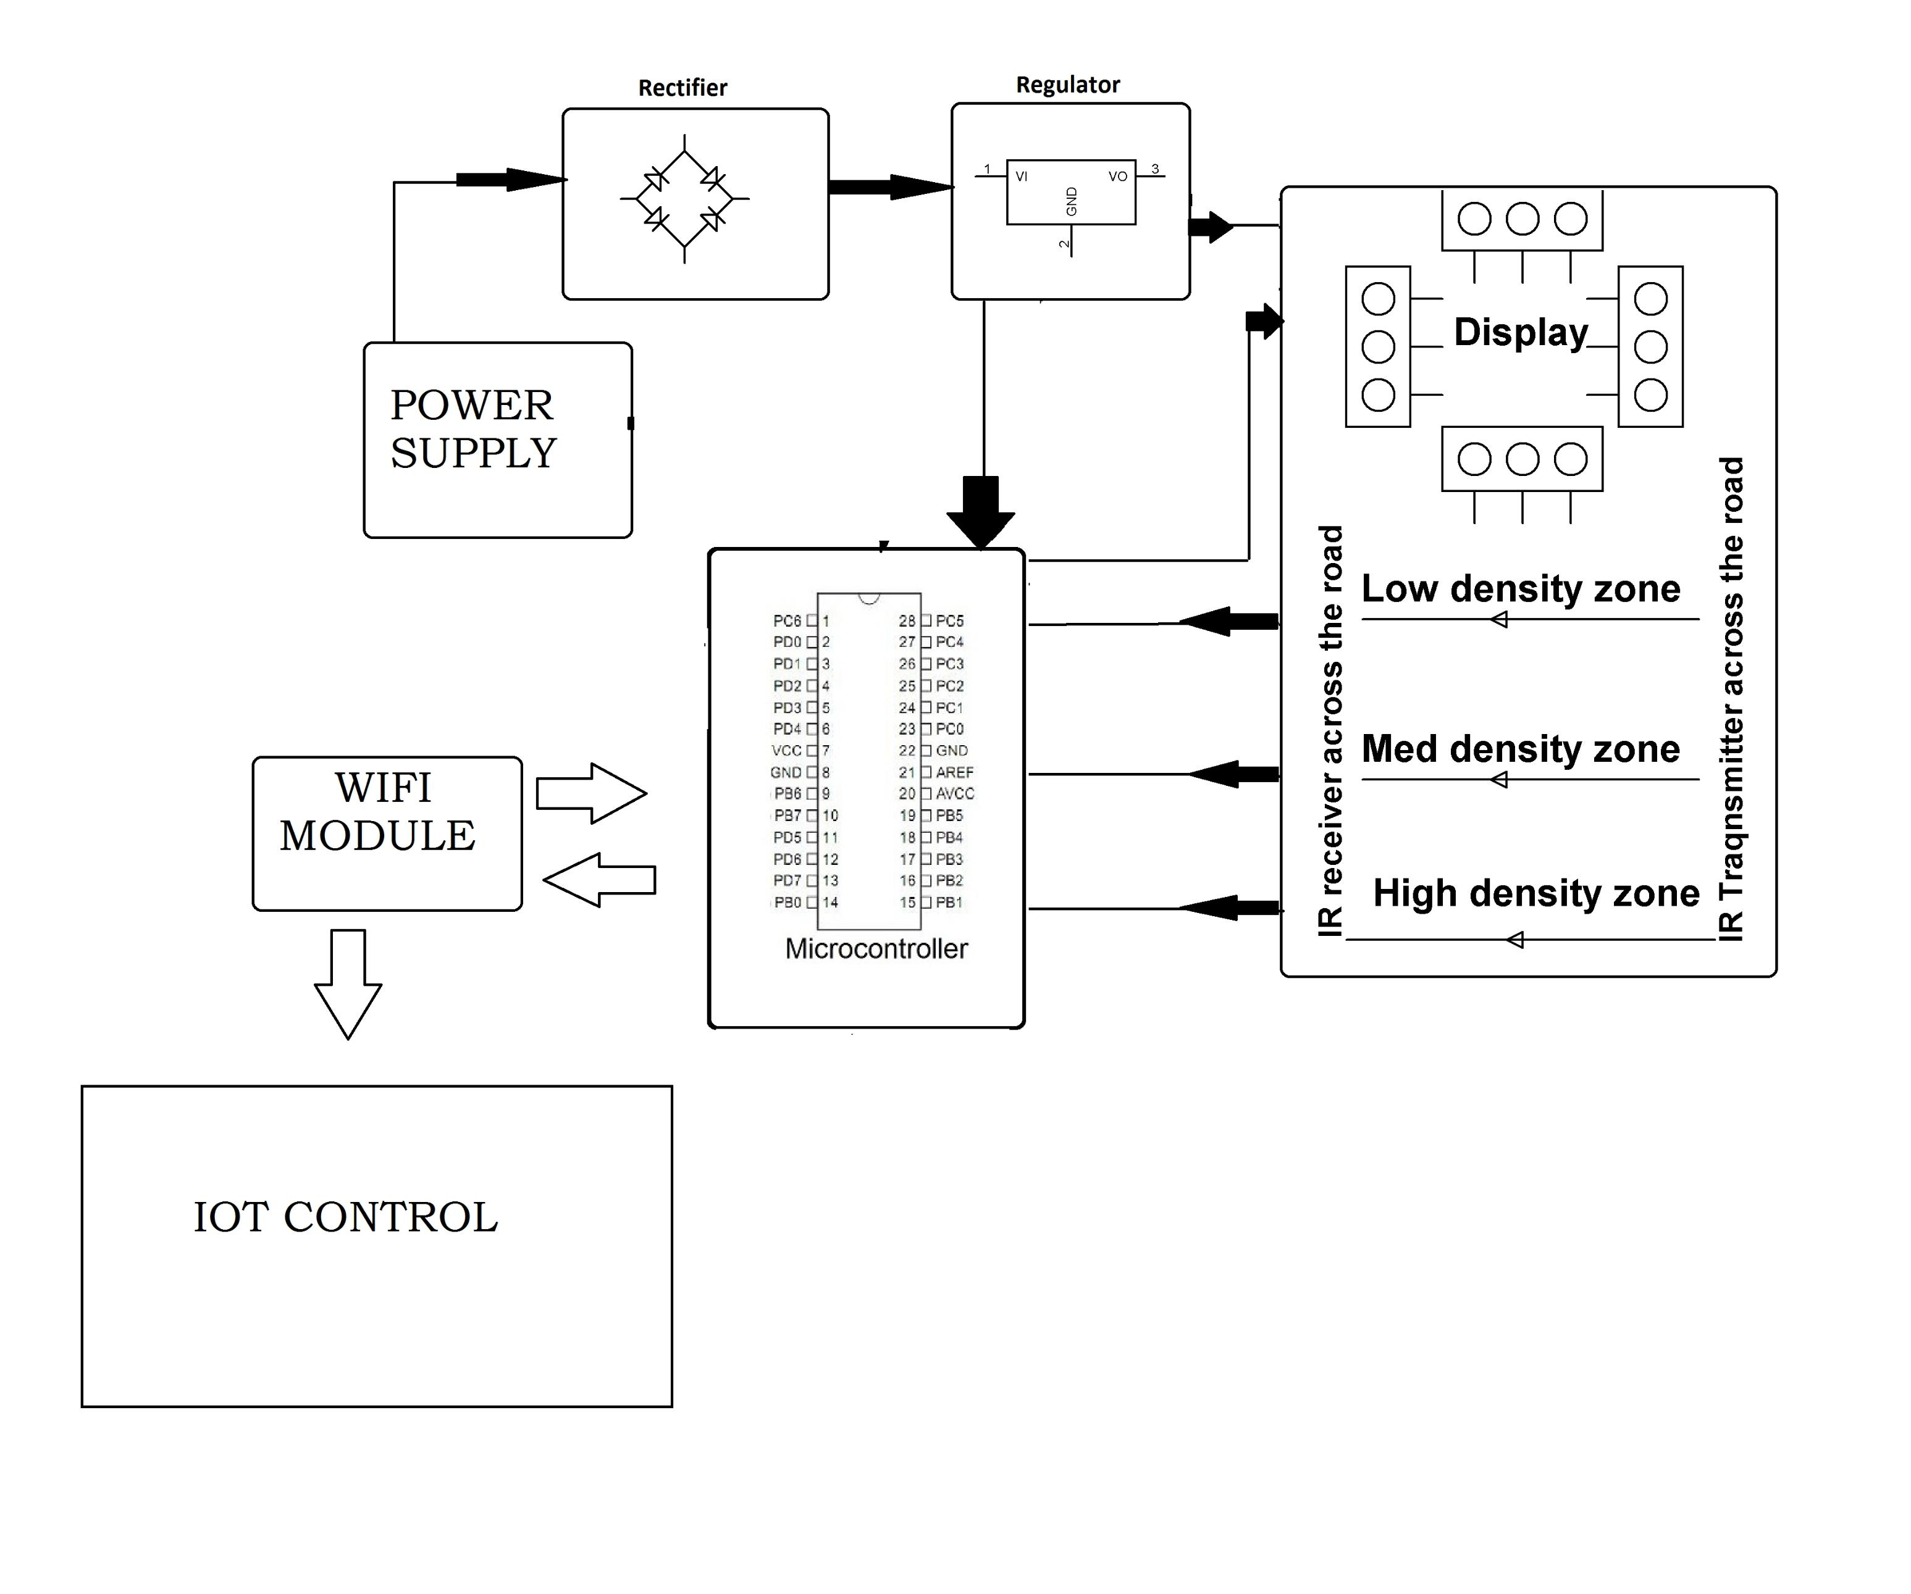
Block Diagram
Power Supply :
Some of the key components are small IoT power supplies,
usually in the 1-20W category, that provide power at the required voltage
for the electronic system that handles sensor input and data transfer to the
internet.
Rectifier:
The rectifier is a device that is used to convert the AC signal into the DC
signal. in the AC signal, we will get two-phase one is positive and the other is
negative.

Slide 4
Regulator:
Voltage Regulators for IoT and Mobile Devices. Power supplies and
power management systems play a critical role in extending a mobile device's
battery life and performance. As a critical part of these systems, a voltage
regulator is designed to maintain the output voltage from a power supply at a
constant value.
WIFI Module:
Wifi modules or wifi microcontrollers are used to send and recieve
data over Wi-Fi. They can also accept commands over the Wi-Fi. Wi-Fi modules
are used for communications bewtween devices. They are most commonly
used in the field of Internet of Thnigs.
Mic Conrtoller:
Microcontrollers are ideal for use in Internet of Things (IoT)
systems because of their small size, low cost, and low energy consumption.
They can be programmed to do many different tasks, making them suitable for
many IOT applications. They are also great for batterypowered devices as they
use less energy.

Slide 5
IOT Controller:
One of the primary advantages of IoT controllers is their ability to
collect data from connected devices and analyse it in real-time. This analysis
enables controllers to make informed decisions and execute commands based
on the data collected. For instance, a smart thermostat can send temperature
data to the controller, which then analyses it and adjusts the temperature in the
room accordingly.
IOT controllers can also monitor and manage the power usage, security, and
performance of connected devices. For example, a smart building controller can
use data from sensors to optimize the use of HVAC systems and lighting,
reducing energy costs and improving efficiency. Likewise, a security controller
can monitor access points and alert security personnel if an unauthorized entry
is detected.
Display :
LED stands for light-emitting diode, they are the most commonly used
and most popular of all the IOT displays. They are usually used for
devices with simple alphanumeric characters and symbol displays.

Slide 6
Advantages of a Smart Traffic Management System
Cleaner, greener, safer, and more accessible roads are a few benefits of implementing IoT and intelligent technology.
It helps with the following:
Reducing traffic jams and accidents on the streets
Ensuring immediate clearance for emergency vehicles
Facilitating safer and shorter commute times
Reducing congestion & energy consumption at intersections
Offering significant productivity benefits with real-time monitoring of crucialinfrastructures
Reducingg operating costs with efficient traffic management processes
Ensuring compliance with the regulations for reducing the carbon footprint
Saving billions of gallons of fuel wasted every year
Accurate tracking & quick recovery of lost and stolen vehicles

Slide 7
In[]:y_predict = lr_clf.predict(x_test_std) print('Predicted chances of flood') print(y_predict)
Predicted chances of flood
[1 0 0 1 0 0 1 0 1 0 0 1 0 0 1 1 1 1 1 0 0 0 1 0]
In[]:print('Actual chances of flood')
print(y_test.values)
In[]:Actual chances of flood
[1 1 0 0 0 0 1 0 1 0 0 0 0 0 1 1 1 0 1 0 0 0 1 0]
In[]:from sklearn.metrics import accuracy score,recall_score,roc_auc_score,confusion_matrix
print("\naccuracy score: %f"%(accuracy_score(y_test,y_predict)*100)) print("recall score: %f"%(recall_score(y_test,y_predict)*100)) print("roc score: %f"%(roc_auc_score(y_test,y_predict)*100))
Out[]:accuracy score: 83.333333
recall score: 88.888889
roc score: 84.444444
3.Decision Tree Classification
In[]:from sklearn.tree import DecisionTreeClassifier dtc_clf = DecisionTreeClassifier() dtc_clf.fit(x_train,y_train)
dtc_clf_acc = ccuracy",n_jobs=-1) dtc_clf_acc
cross_val_score(dtc_clf,x_train_std,y_train,cv=3,scoring="a
Out[]:array([0.71875 , 0.64516129, 0.61290323])
In[]:#Predicted flood chances
y_pred = dtc_clf.predict(x_test) print(y_pred)
[1 1 0 0 0 0 1 0 1 0 0 1 1 1 1 0 0 1 1 0 1 0 1 0]

Slide 8
In []:#Actual flood chances print("actual values:") print(y_test.values)
actual values:
[1 1 0 0 0 0 1 0 1 0 0 0 0 0 1 1 1 0 1 0 0 0 1 0]
In[]:from sklearn.metrics import accuracy_score,recall_score,roc_auc_score,confusion_matrix print("\naccuracy score:%f"%(accuracy_score(y_test,y_pred)*100))
print("recall score:%f"%(recall_score(y_test,y_pred)*100)) print("roc score:%f"%(roc_auc_score(y_test,y_pred)*100)) accuracy score:70.833333
recall score:77.777778 roc score:72.222222
4.Random Forest Classification:
In[]:from sklearn.ensemble import RandomForestClassifier
rmf = RandomForestClassifier(max_depth=3,random_state=0) rmf_clf = rmf.fit(x_train,y_train)
rmf_clf
Out[]:RandomForestClassifier(max_depth=3, random_state=0) rmf_clf_acc =
cross_val_score(rmf_clf,x_train_std,y_train,cv=3,scoring="accuracy",n_jobs=-1)
In[]:#rmf_proba = cross_val_predict(rmf_clf,x_train_std,y_train,cv=3,method='predict_proba') In[]:rmf_clf_acc
Out[]:array([0.8125 , 0.67741935, 0.87096774])
In[]:y_pred = rmf_clf.predict(x_test)
In[]: from sklearn.metrics import accuracy_score,recall_score,roc_auc_score,confusion_matrix print("\naccuracy score:%f"%(accuracy_score(y_test,y_pred)*100)) print("recall score:%f"%(recall_score(y_test,y_pred)*100)) print("roc score:%f"%(roc_auc_score(y_test,y_pred)*100))
accuracy score:79.166667 recall score:100.000000 roc score:83.333333

Slide 9
5.Ensemble Learning
In[]:from sklearn.ensemble import VotingClassifier from sklearn.ensemble import RandomForestClassifier from sklearn.linear_model import LogisticRegression from sklearn.neighbors import KNeighborsClassifier
log_clf = LogisticRegression(solver="liblinear", random_state=42) rnd_clf = RandomForestClassifier(n_estimators=10, random_state=42) knn_clf = KNeighborsClassifier()
voting = VotingClassifier(
estimators=[('lr', log_clf), ('rf', rnd_clf), ('knn', knn_clf)], voting='hard')
In[]:voting_clf = voting.fit(x_train, y_train) from sklearn.metrics import accuracy_score
In[]:for clf in (log_clf, rnd_clf, knn_clf, voting_clf): clf.fit(x_train, y_train)
y_pred = clf.predict(x_test)
print(clf. class . name , accuracy_score(y_test, y_pred))
LogisticRegression 0.9583333333333334
RandomForestClassifier 0.7083333333333334
KNeighborsClassifier 0.9166666666666666
VotingClassifier 0.9166666666666666

Slide 10
Comparing All Prediction Models
In[]:models = []
from sklearn.neighbors import KNeighborsClassifier from sklearn.linear_model import LogisticRegression from sklearn.tree import DecisionTreeClassifier
from sklearn.svm import SVC
from sklearn.ensemble import RandomForestClassifier from sklearn.ensemble import VotingClassifier models.append(('KNN', KNeighborsClassifier())) models.append(('LR', LogisticRegression())) models.append(('DT', DecisionTreeClassifier())) models.append(('RF', RandomForestClassifier())) models.append(('EL', VotingClassifier(
estimators=[('lr', log_clf), ('rf', rnd_clf), ('knn', knn_clf)], voting='hard')))
names = [] scores = []
for name, model in models:
model.fit(x_train, y_train) y_pred = model.predict(x_test)
scores.append(accuracy_score(y_test, y_pred)) names.append(name)
tr_split = pd.DataFrame({'Name': names, 'Score': scores})
print(tr_split)
Name Score
0 KNN 0.916667
1 LR 0.958333
2 DT 0.750000
3 RF 0.916667
4 EL 0.916667
/opt/conda/lib/python3.7/site-packages/sklearn/linear_model/_logistic.py:764: ConvergenceWarning: lbfgs failed to converge (status=1):
STOP: TOTAL NO. of ITERATIONS REACHED LIMIT.

Slide 11
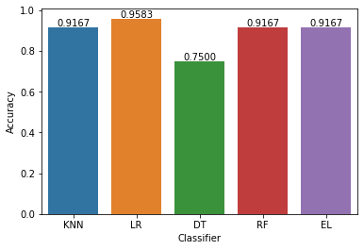
In[]:import seaborn as sns
axis = sns.barplot(x = 'Name', y = 'Score', data =tr_split ) axis.set(xlabel='Classifier', ylabel='Accuracy')
for p in axis.patches: height = p.get_height()
axis.text(p.get_x() + p.get_width()/2, height + 0.005, '{:1.4f}'.format(height), ha="center")
plt.show() Output:
Conclusion and future Work(Phase 2):
Project Conclusion:
Flood monitoring systems are indispensable tools for mitigating the devastating impacts of floods.
By continuously collecting and analyzing data, issuing early warnings, and facilitating coordinated responses, these systems play a crucial role in safeguarding lives and property.
Future Work: Future work in flood monitoring systems should aim to provide more accurate and timely information, improve the resilience of communities and infrastructure, and enhance our ability to mitigate the impact of floods in an era of changing climate patterns.

